Slide 1
Priyadarshini College of Engineering
Department of Artificial Intelligence and Data Science
Project by:- Adarsh Sonkusre

Slide 2
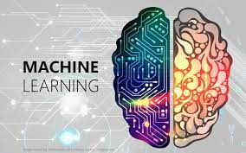
Sign language detection using machine learning

Slide 3
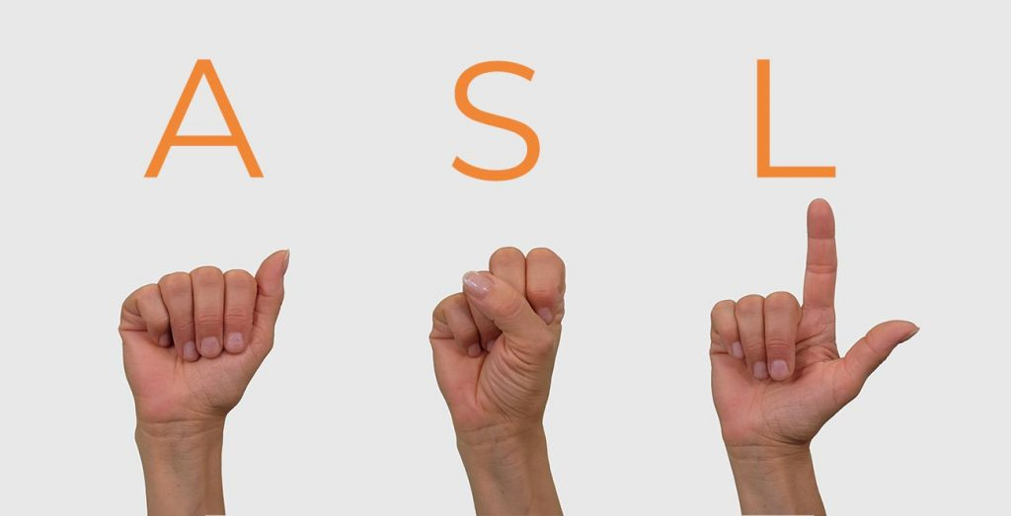
AGENDA
Sign language is learned by deaf and dumb, and usually it is not known to normal people, so it becomes a challenge for communication between a normal and hearing impaired person.
So, our agenda and the end goal is to create a machine learning model to help normal people to understand the sign language.

Slide 4
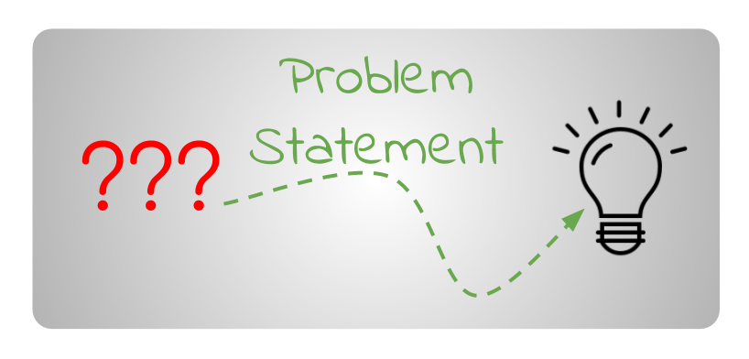
PROBLEM STATEMENT
So, our goal is to build a sign language detection system using ml which has highest accuracy rate possible and also cost effective at the same time
What are the limitations of sign language recognition?
The disadvantages are that they are costly and are difficult to be used commercially. Classification methods are also varying from researchers. Researchers tend to develop their own concept, based on known methods, to give better result in recognizing the sign language

Slide 5

PROJECT OVERVIEW
We will be using python language to program a machine learning model also packages from python like tensorflow, keras, opencv etc.

Slide 6

WHO ARE THE END USERS?
The end users can be normal peoples like us who couldn't understand the sign language and these people also it can be embedded with the hardware device for the mute and deaf individual to carry with them.

Slide 7
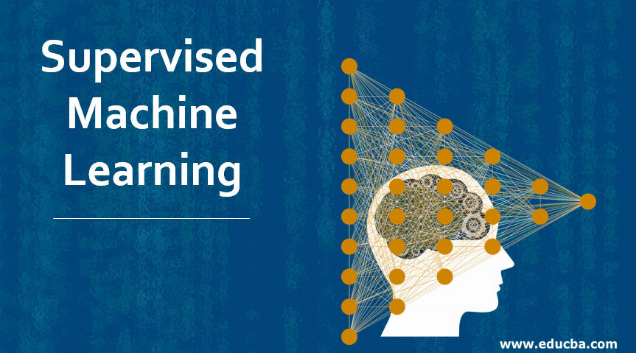
SOLUTION
The given problem can be solved using the machine learning techniques to be specific supervised machine learning approach where we are providing the training data to the machine and then testing the model using the test data

Slide 8
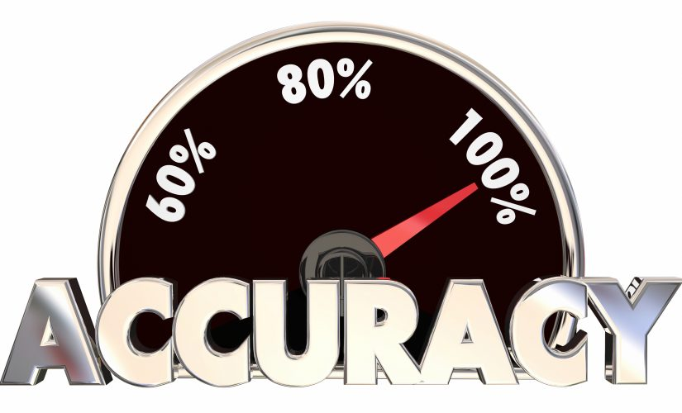
THE “WOW” FACTOR
The key goal of the model is to achieve 99% accuracy

Slide 9
Code
Sign Language Model-Copy1new - Jupyter Notebook

Slide 10
References
For database :- Internet and Self Made database
For modeling :- Machine Learning by Tom Mitchell, Mc.Graw Publications

Slide 11
Thank You!!!

